Slide 1
Operating Systems

Slide 2
Overview of Operating Systems
Chapter 1

Slide 3
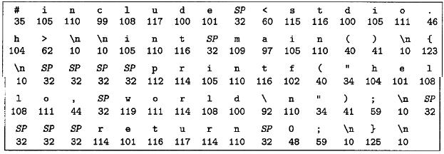
Information
Information = Bit + Context
Information is stored using binary

Slide 4

Program
Program is translated to different context
Source code is for human
Machine code is for computer
Compilation: from source code to ELF (machine code)

Slide 5
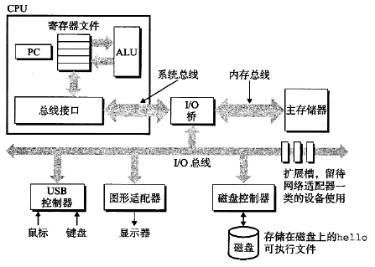
Computer Structure
Bus: transfer data to different components of hardware.
IO device: for input and output.
Memory: DRAM chip to store data temporarily.
CPU: load, store, handle, jump ELF.

Slide 6
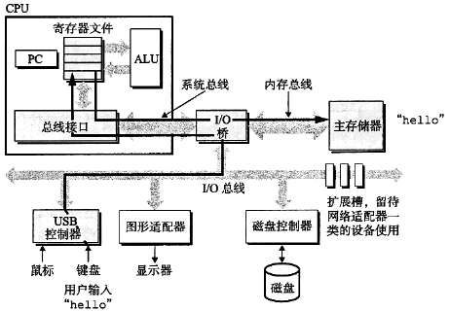
Running of Program
User input

Slide 7
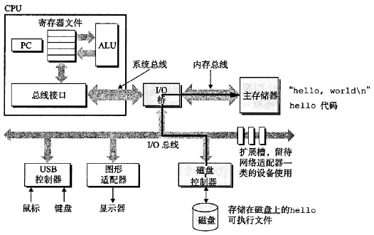
Running of Program
Load to memory

Slide 8
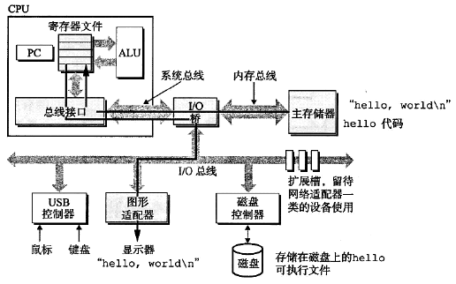
Running of Program
Processing and output

Slide 9
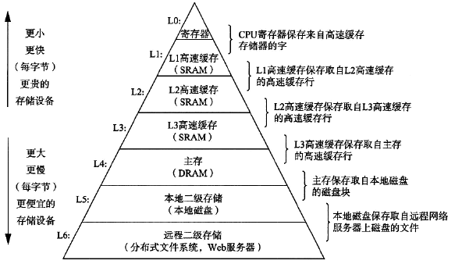
Storage Hierarchy
Faster is expensive
Trade-off between speed and cost

Slide 10

Operating Systems
OS prevents hardware to be manipulated by program.
OS offers abstract of complex hardware and drives.

Slide 11
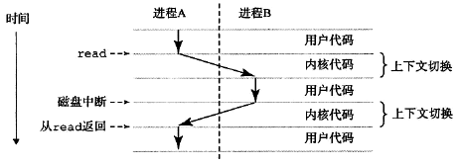
Operating Systems
Context: status of program running.
OS uses context and system call to schedule programs.

Slide 12
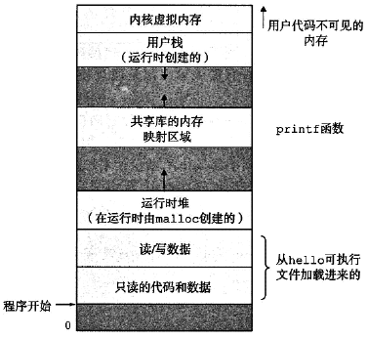
Operating Systems
Process is the minimal running unit of program.
Virtual memory is the abstract of program running.

Slide 13
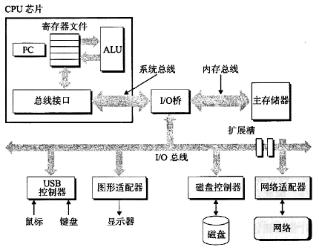
Networking
Network connects different computers.

Slide 14
Storage of Information and Program
Chapter 2

Slide 15
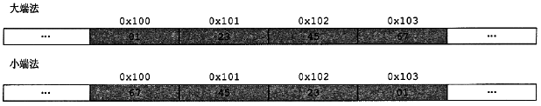
Storage of Information
Computer uses binary to store information
Each binary 0 or 1 calls a bit.
Every 8 bits calls a byte.
32 bit system: every 4 byte calls a word.
64 bit system: every 8 byte calls a word.
Each byte has an address (usually in hexadecimal).
Addressing using big-endian or little-endian.

Slide 16
Decimal
unsigned / signed: most significant bit is data or sign.
1’s complement / 2’s complement presentation.
byte: [-128, 127]
short: [-32 768, 32 767]
int: [-2 147 483 648, 2 147 483 647]
long: [-9 223 372 036 854 775 808, 9 223 372 036 854 775 807]
Overflow: result of arithmetic larger than bound.

Slide 17
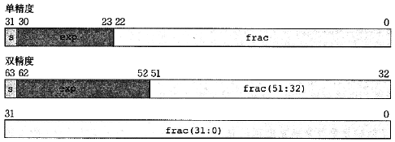
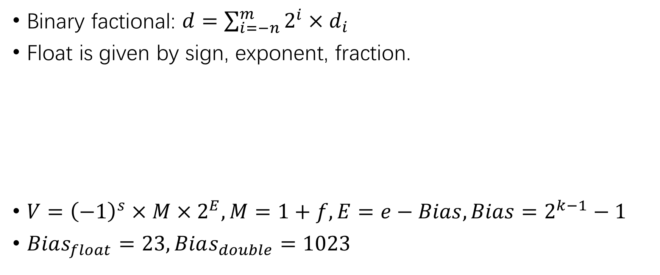
Float
Binary factional: $d=\sum_{i=−n}^{m}{2^{i}×d_{i}}$
Float is given by sign, exponent, fraction.
$V={\left(−1\right)}^{s}×M×2^{E}, M=1+f, E=e−Bias, Bias=2^{k−1}−1$
$Bias_{float}=23, Bias_{double}=1023$

Slide 18
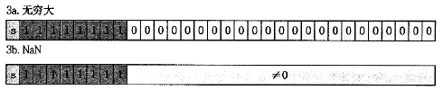
Float
Special values of float:
Float is an approximate value, sometimes round to nearest.
Float arithmetic follows the same rules of decimals.

Slide 19
Program Encoding
Assembly code (x86-64)
PC: program counter, stores the address of next instruction.
Decimal register: 16 of them, stores decimals.
State code register: perform conditional jump.
Vector register: an array of decimals or floats.
GCC is a program to compile programs.
Dis-assembler uses assembly to generate source code.

Slide 20
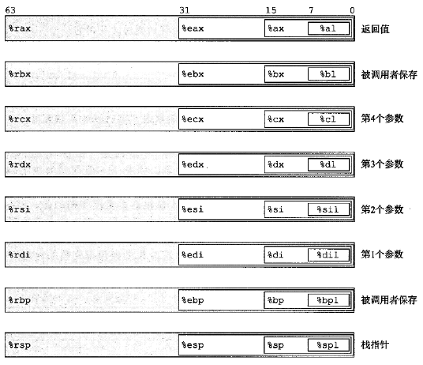
Register
%rax, %eax, %ax, %al

Slide 21
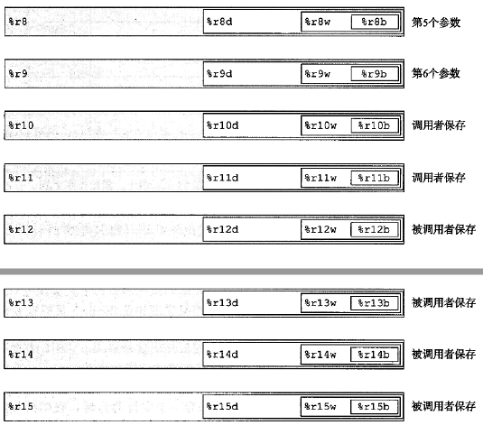
Register

Slide 22
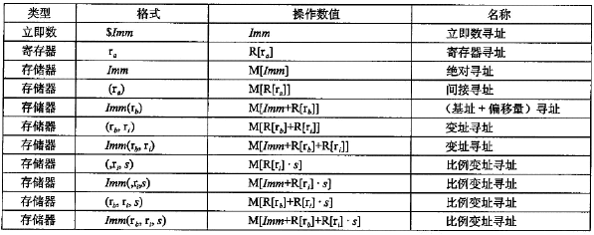
Operand
Immediate number: $0x1F $-577
Register: %rax %al
Memory address: (%rbp) 4(%rbp)

Slide 23
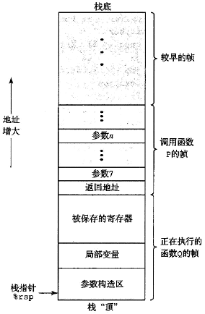
Stack
Stack is consists of stack frames.

Slide 24
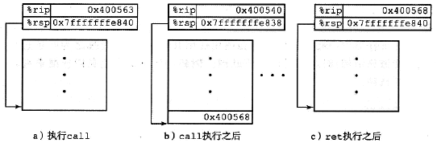
Calling Convention
Calling a function creates a new stack frame.
The information of old stack frame is stored to stack.
The return address and return value is stored in stack.

Slide 25
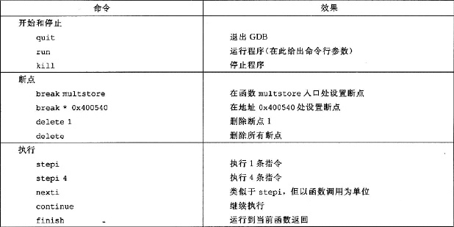
GDB Debugger
GDB debugger is used to dynamically debug program.

Slide 26
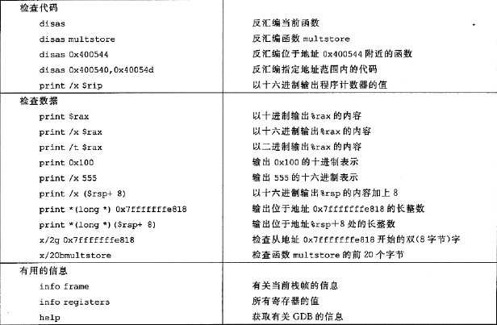
GDB Debugger

